Slide 1

INTERNATIONAL INSITITUTE OF MEDICAL SCIENCE AND TECHNOLOGY
Indian Social Institute, 24, Benson Rd, Byadarahalli, Benson Town, Bengaluru, Karnataka 560046
Mini Project
AQUALIFE COASTAL WATCH
Presented by: cohort 05

Slide 2
Introduction
Oceans and coastal ecosystems play a vital role in maintaining biodiversity and supporting marine life. However, increasing coastal pollution, marine debris, and human activities are causing serious threats to marine habitats and endangered species. Monitoring these environmental issues is challenging because traditional methods rely on limited surveys and lack real-time data collection.
The AquaLife Coastal Watch project aims to develop a citizen science web application that allows people to report coastal pollution and marine wildlife sightings. By enabling users to upload geo-tagged images and environmental observations, the platform helps create a real-time monitoring system that supports conservation agencies in identifying pollution hotspots and protecting marine ecosystems

Slide 3
Problem Statement
Despite increasing concerns about marine pollution and endangered species, there is no centralized system that allows citizens to easily report coastal environmental issues.
Traditional monitoring systems rely on manual surveys, which are time-consuming and limited in coverage. As a result, many pollution incidents and wildlife sightings go undocumented.
The absence of real-time data and transparent monitoring creates challenges for marine conservationists to identify pollution hotspots and respond quickly. Therefore, there is a need for a reliable platform that enables crowd-sourced reporting and verified environmental monitoring.

Slide 4
Sustainable Development Goal (SGD) - 14
Life Below Water:
Objectives of SDG 14
• Reduce marine pollution from land-based activities • Protect and restore marine ecosystems • Conserve coastal and marine biodiversity • Prevent damage to marine habitats • Promote sustainable use of ocean resources
Objectives of SDG 14
• Reduce marine pollution from land-based activities • Protect and restore marine ecosystems • Conserve coastal and marine biodiversity • Prevent damage to marine habitats • Promote sustainable use of ocean resources

Slide 5
Proposed Solution
The proposed system AquaLife Coastal Watch introduces a citizen-driven platform to monitor coastal pollution and marine wildlife sightings.Through geo-tagged reporting, moderator validation, and real-time data visualization, the platform helps environmental agencies detect pollution hotspots and take timely action.
Innovation
Approach
Advantages
A community-driven platform that allows citizens to report coastal pollution and marine wildlife sightings . The system helps create real-time environmental data to support marine conservation and pollution monitoring..
Citizens submit reports with images and location data. Moderators verify submissions before publishing them on a public dashboard.
• Verified environmental reporting • Faster response by conservation agencies • Real-time pollution hotspot detection • Increased public participation in conservation

Slide 6
Objectives
01
02
Community-Based Reporting
Report Validation Mechanism
To provide a platform where citizens can easily report coastal pollution and marine wildlife sightings with location details and images.
To implement moderator validation to ensure authenticity and reliability of submitted reports.
03
04
Transparent Issue Tracking
Efficient Authority Communication
To create a public dashboard that tracks pollution incidents and wildlife sightings in real time.
To help conservation authorities identify pollution hotspots and respond efficiently.

Slide 7


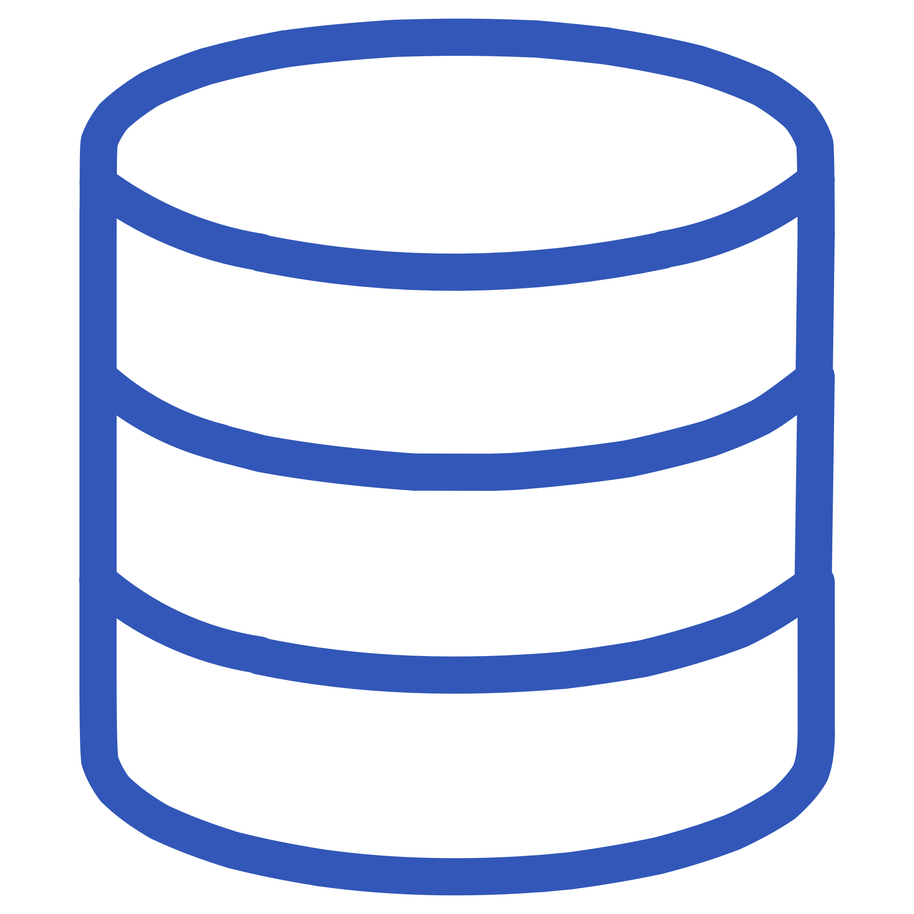

Technology Stack
Frontend
Backend
React.js – Used to build dynamic and responsive user interfaces.
Node.js – Server-side runtime environment.
Express.js – Framework for handling routing and server logic.
Database
Development Tools
MongoDB – NoSQL database for storing users, reports, and forum data.
VS Code – Code editor, Git & GitHub – Version control, Figma – UI/UX design

Slide 8
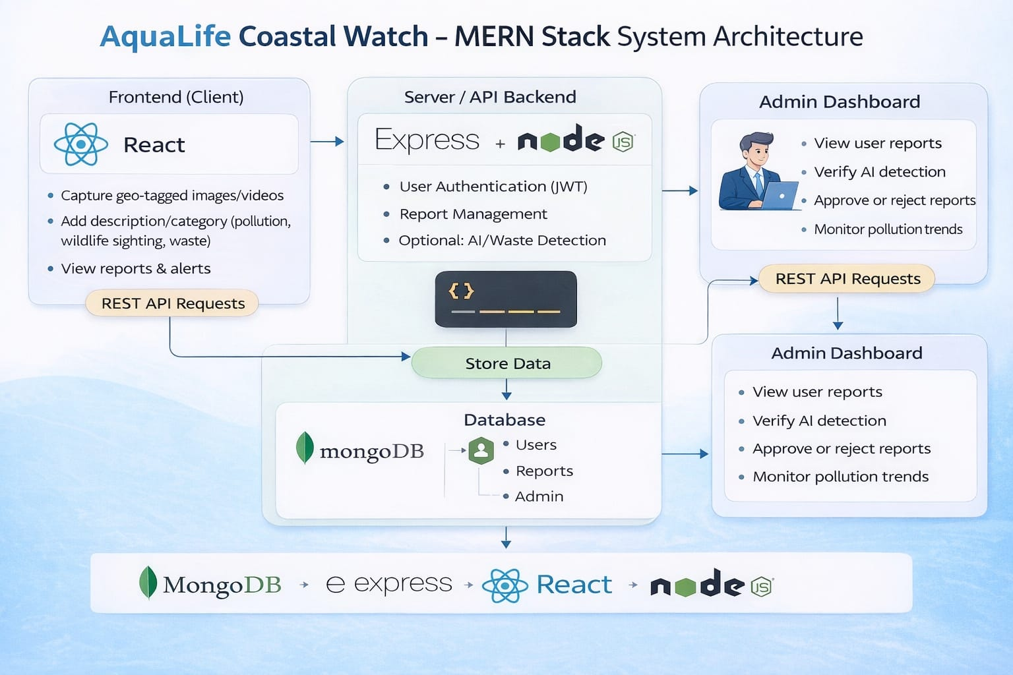
System Architecture

Slide 9
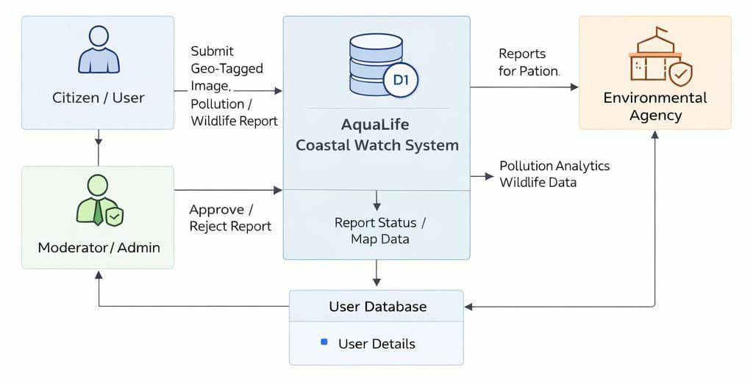
Implementation
Data Flow Diagram 0

Slide 10
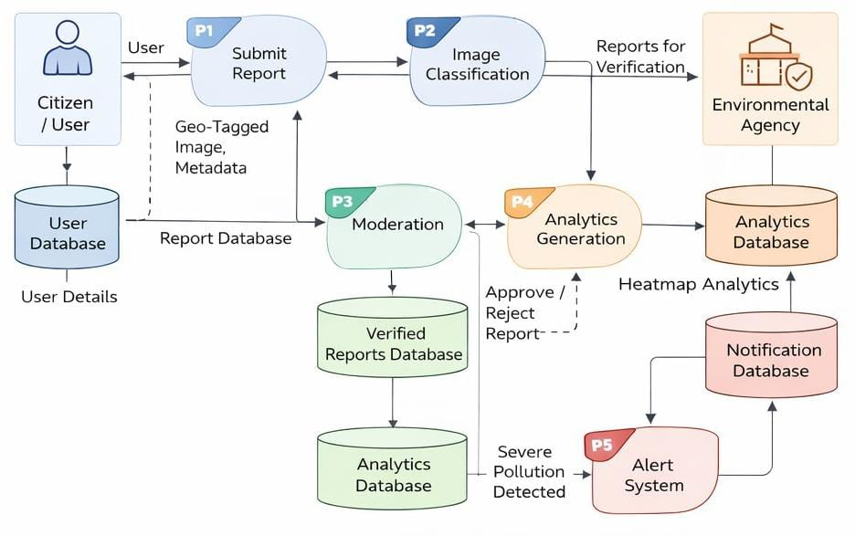
Data Flow Diagram 1

Slide 11
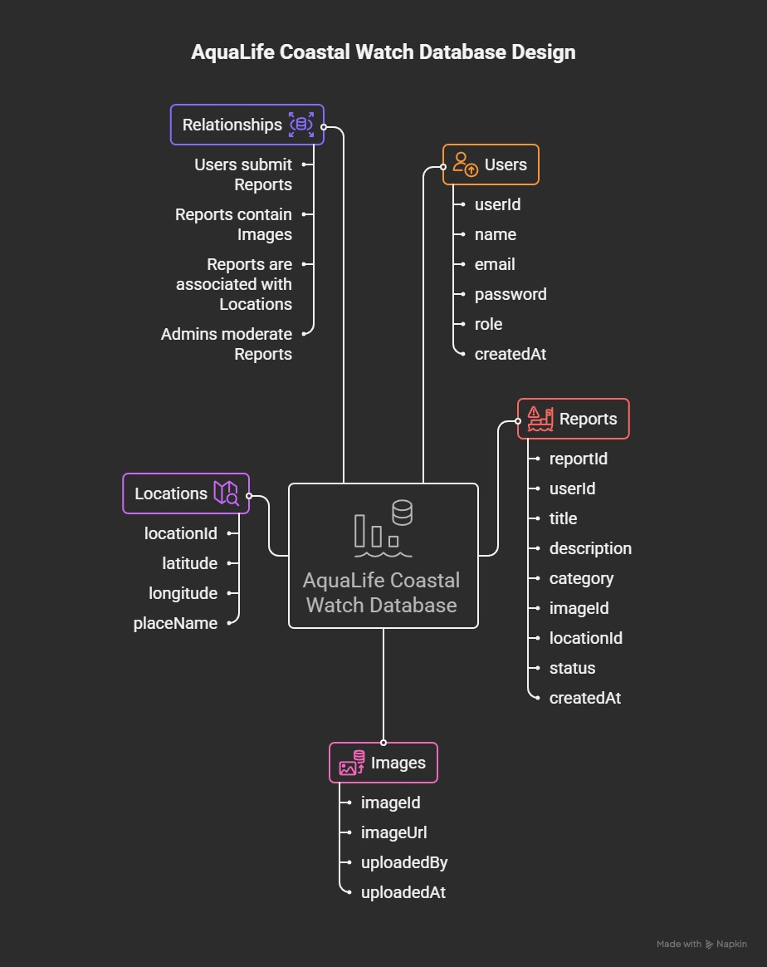
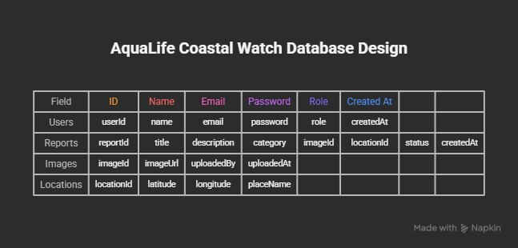
Database Design

Slide 12
Future Enhancements
AI-Based Image Analysis
Government Data Integration
Use machine learning to automatically detect pollution types or marine species from uploaded images.
Connect with marine protection agencies for faster action.
Mobile Application Development
Enhanced Security
Develop Android/iOS apps to allow easier and faster reporting from coastal areas.
Add multi-factor authentication and stronger data protection
mechanisms
Satellite & IoT Integration
Advanced Data Analytics
Integrate environmental sensors and satellite data for better monitoring.
Identify pollution trends and predict high-risk coastal areas.

Slide 13
Conclusion
AquaLife Coastal Watch provides a community-driven platform for monitoring coastal pollution and marine wildlife sightings. The system allows citizens to actively participate in environmental protection by reporting pollution incidents and wildlife observations using geo-tagged images and location data.
By combining citizen participation, real-time reporting, moderator validation, and environmental analytics, the platform helps identify pollution hotspots and supports faster action from conservation agencies. This project promotes transparency, environmental awareness, and collaborative efforts in protecting marine ecosystems, while supporting the goals of Sustainable Development Goal (SDG) 14 – Life Below Water.

Slide 14
Thank You

